Slide 1


Attitude estimation with Extended Kalman Filter
Mirko Mazzoleni
Corso di IDENTIFICAZIONE DEI MODELLI E ANALISI DEI DATI
A.A. 2018/2019

Slide 2
Outline
Introduction
Model
Preprocessing and implementation of EKF

Slide 3
Outline
Introduction
Model
Preprocessing and implementation of EKF

Slide 4
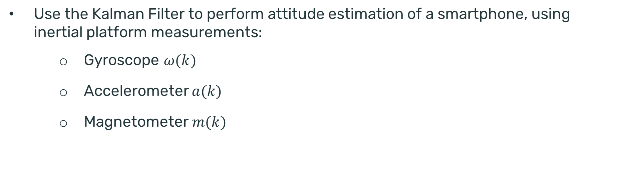
Scope of the laboratory
Use the Kalman Filter to perform attitude estimation of a smartphone, using inertial platform measurements:
Gyroscope $ω(k)$
Accelerometer $a(k)$
Magnetometer $m(k)$
Reference ➔ Orientation Estimation using Smartphone Sensors – Linkoping university
LPT: Access SAMSUNG smartphone sensors with the combination: *#0*#

Slide 5
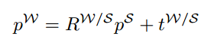
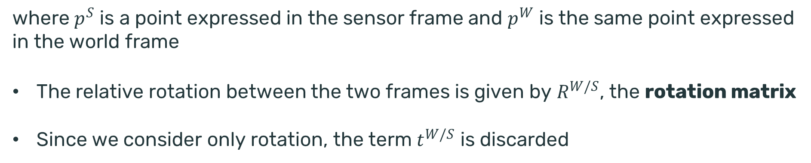
Frames
Reference ➔ Robotica: modellistica, simulazione e controllo
Siciliano, Sciavicco, Villani, Oriolo
We will use two coordinate systems: the world frame and the sensor frame
These coordinate systems are related via linear transformations
where $p^{S}$ is a point expressed in the sensor frame and $p^{W}$ is the same point expressed in the world frame
The relative rotation between the two frames is given by $R^{W/S}$, the rotation matrix
Since we consider only rotation, the term $t^{W/S}$ is discarded

Slide 6
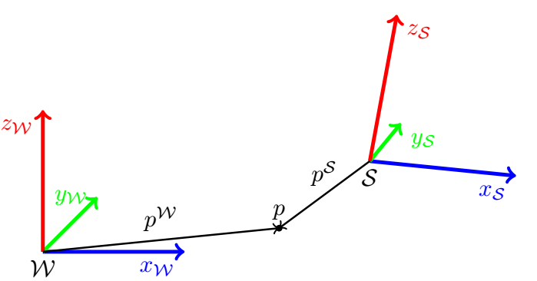
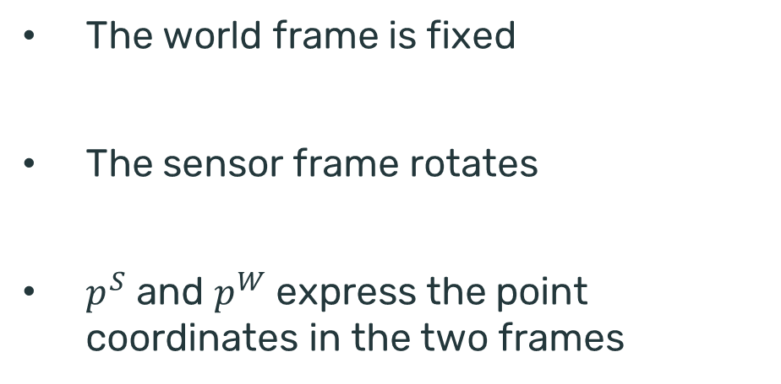
Frames
The world frame is fixed
The sensor frame rotates
$p^{S}$ and $p^{W}$ express the point coordinates in the two frames
The focus of this lab is to estimate the rotation 𝑅^(𝑊/𝑆) based on the sensors measurements available from a smartphone
By estimating 𝑅^(𝑊/𝑆) we are able to obtain the object attitude in the fixed frame

Slide 7
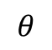
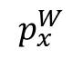
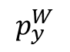
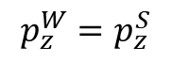
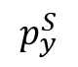
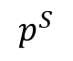
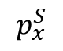
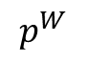
Frames
A rotation matrix has 3 meanings
Gives the orientation of one set of coordinates with respect to another
Represents a transformation of coordinates that relates the coordinates of the same point in two different frames
Is the operator which rotates a vector in the same frame
$$p^{W}$$
$$p_{y}^{W}$$
$$p^{S}$$
$$p_{y}^{S}$$
$$θ$$
$$p_{x}^{W}$$
$$p_{x}^{S}$$
$$p_{z}^{W}=p_{z}^{S}$$

Slide 8
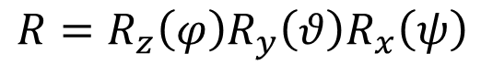
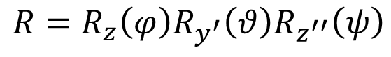
Attitude representation
An object attitude can be expressed via rotation matrices (9 elements)
The 9 elements are not independent because of orthogonality constraints ➔ 3 indenpendent parameters (3 angles)
Euler angles
PROBLEM: Singularities
$$R=R_{z}\left(φ\right)R_{y^{′}}\left(θ\right)R_{z^{′′}}\left(ψ\right)$$
ZYZ representation (current frame)
Different positions in the same have the same representation
$$R=R_{z}\left(φ\right)R_{y}\left(θ\right)R_{x}\left(ψ\right)$$
RPY representation (fixed frame)

Slide 9
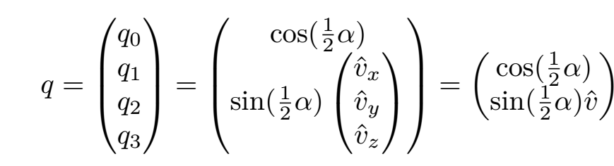
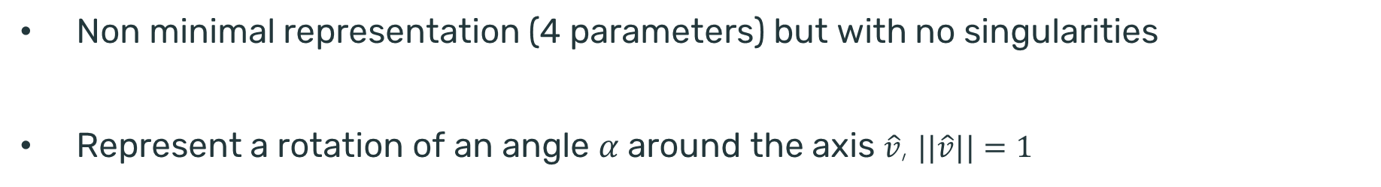
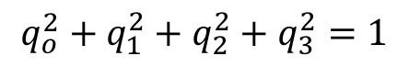
Quaternions
Non minimal representation (4 parameters) but with no singularities
Represent a rotation of an angle 𝛼 around the axis $\hat{v}$, $||\hat{v}||=1$
$$q_{o}^{2}+q_{1}^{2}+q_{2}^{2}+q_{3}^{2}=1$$
We have that $q$ and $−q$ represent the same rotation. So the representation of a rotation must be chosen according to the specific application

Slide 10
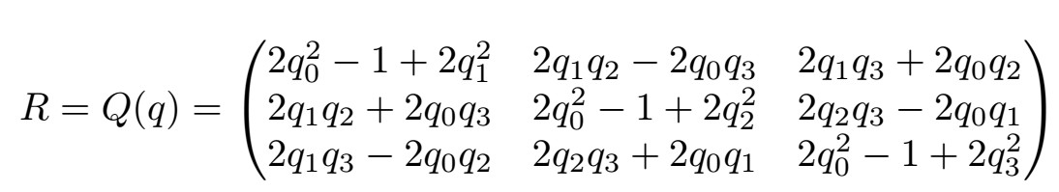
Rotation matrix corresponding to a quaternion

Slide 11
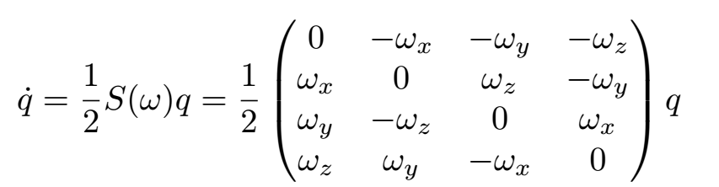
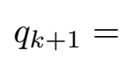
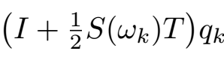
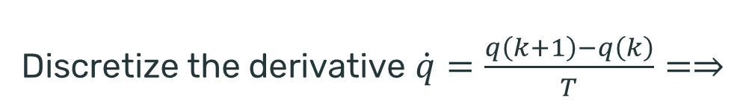
Time derivative of a quaternion
Discretize the derivative $\dot{q}=\frac{q\left(k+1\right)−q\left(k\right)}{T}=⇒$

Slide 12
Outline
Introduction
Model
Preprocessing and implementation of EKF

Slide 13
Simple model
The unknown states are the quaternion components. We want to estimate them in order to obtain the object attitude which we do not measure (4-d vector)
Input: gyroscope measurements (3-d vector)
Outputs: accelerometers and magnetometer measurements (6-d vector)

Slide 14
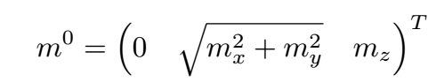
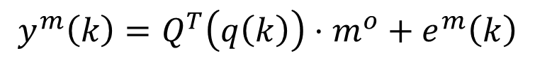
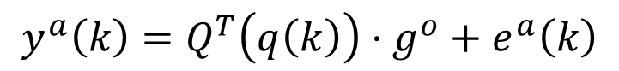
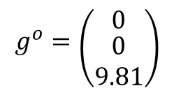
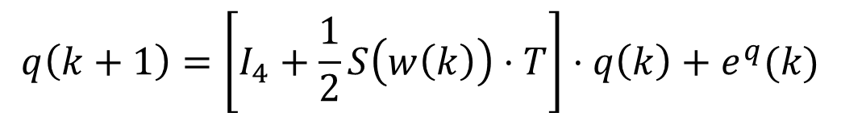
Model state space equations
$$q\left(k+1\right)=\left[I_{4}+\frac{1}{2}S\left(w\left(k\right)\right)⋅T\right]⋅q\left(k\right)+e^{q}(k)$$
$$g^{o}=\left({0 \atop \begin{aligned}0 \\ 9.81\end{aligned}}\right)$$
$$y^{a}\left(k\right)=Q^{T}\left(q\left(k\right)\right)⋅g^{o}+e^{a}\left(k\right)$$
$$y^{m}\left(k\right)=Q^{T}\left(q\left(k\right)\right)⋅m^{o}+e^{m}\left(k\right)$$

Slide 15
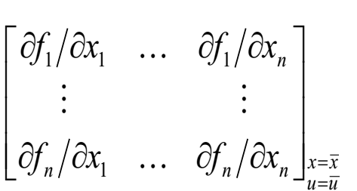
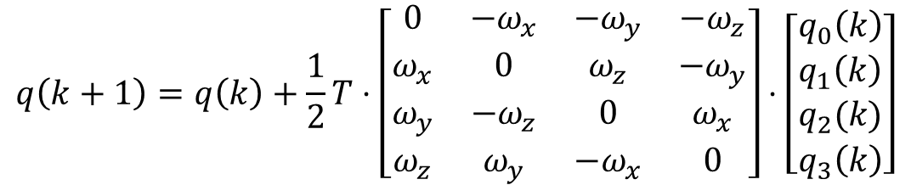
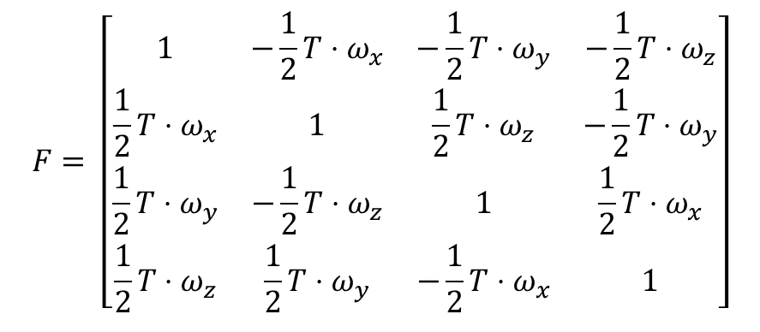
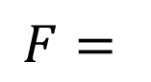
Linearization – state space matrix $F_{4×4 }$
$$q\left(k+1\right)=q\left(k\right)+\frac{1}{2}T⋅\left[\begin{matrix}0 & −ω_{x} & −ω_{y} & −ω_{z} \\ ω_{x} & 0 & ω_{z} & −ω_{y} \\ ω_{y} & −ω_{z} & 0 & ω_{x} \\ ω_{z} & ω_{y} & −ω_{x} & 0\end{matrix}\right]⋅\left[\begin{matrix}q_{0}\left(k\right) \\ q_{1}\left(k\right) \\ q_{2}(k) \\ q_{3}\left(k\right)\end{matrix}\right]$$
$$F= \left[\begin{matrix}1 & −\frac{1}{2}T⋅ω_{x} & −\frac{1}{2}T⋅ω_{y} & −\frac{1}{2}T⋅ω_{z} \\ {\frac{1}{2}T⋅ω}_{x} & 1 & \frac{1}{2}T⋅ω_{z} & −{\frac{1}{2}T⋅ω}_{y} \\ \frac{1}{2}T⋅ω_{y} & −{\frac{1}{2}T⋅ω}_{z} & 1 & \frac{1}{2}T⋅ω_{x} \\ \frac{1}{2}T⋅ω_{z} & {\frac{1}{2}T⋅ω}_{y} & −\frac{1}{2}T⋅ω_{x} & 1\end{matrix}\right]$$
$$F=$$

Slide 16
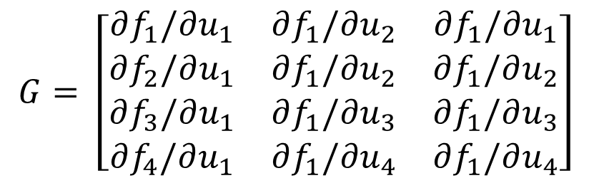
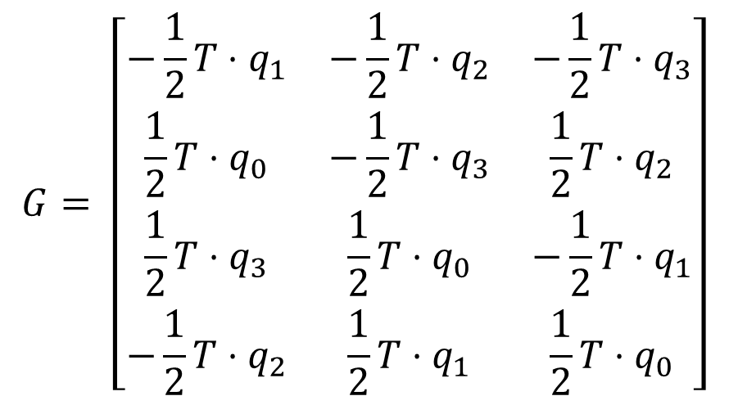
Linearization – input matrix $G_{4×3 }$
$$G= \left[\begin{matrix}∂f_{1}/∂u_{1} & ∂f_{1}/∂u_{2} & ∂f_{1}/∂u_{1} \\ ∂f_{2}/∂u_{1} & ∂f_{1}/∂u_{2} & ∂f_{1}/∂u_{2} \\ ∂f_{3}/∂u_{1} & ∂f_{1}/∂u_{3} & ∂f_{1}/∂u_{3} \\ ∂f_{4}/∂u_{1} & ∂f_{1}/∂u_{4} & ∂f_{1}/∂u_{4}\end{matrix}\right]$$
$$G= \left[\begin{matrix}−\frac{1}{2}T⋅q_{1} & −\frac{1}{2}T⋅q_{2} & −\frac{1}{2}T⋅q_{3} \\ \frac{1}{2}T⋅q_{0} & −\frac{1}{2}T⋅q_{3} & \frac{1}{2}T⋅q_{2} \\ \frac{1}{2}T⋅q_{3} & \frac{1}{2}T⋅q_{0} & −\frac{1}{2}T⋅q_{1} \\ −\frac{1}{2}T⋅q_{2} & \frac{1}{2}T⋅q_{1} & \frac{1}{2}T⋅q_{0}\end{matrix}\right]$$

Slide 17
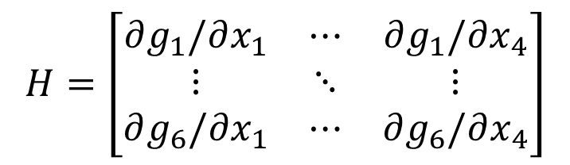
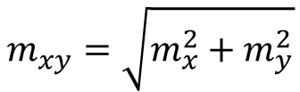
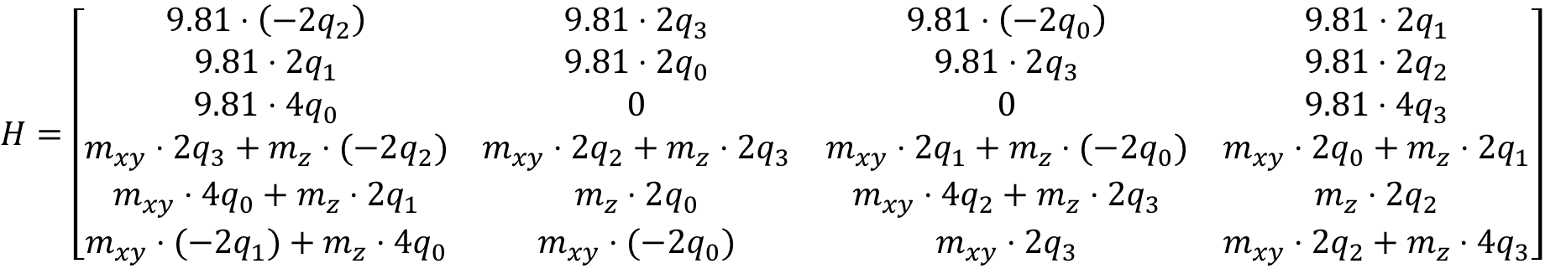
Linearization – Output matrix $H_{6×4 }$
$$H=\left[\begin{matrix}∂g_{1}/∂x_{1} & ⋯ & ∂g_{1}/∂x_{4} \\ ⋮ & ⋱ & ⋮ \\ ∂g_{6}/∂x_{1} & ⋯ & ∂g_{6}/∂x_{4}\end{matrix}\right]$$
$$m_{xy}=\sqrt{m_{x}^{2}+m_{y}^{2}}$$
$$H=\left[\begin{matrix}9.81⋅\left(−2q_{2}\right) & 9.81⋅2q_{3} & 9.81⋅\left(−2q_{0}\right) & 9.81⋅2q_{1} \\ 9.81⋅2q_{1} & 9.81⋅2q_{0} & 9.81⋅2q_{3} & 9.81⋅2q_{2} \\ 9.81⋅4q_{0} & 0 & 0 & 9.81⋅4q_{3} \\ m_{xy}⋅2q_{3}+m_{z}⋅(−2q_{2}) & m_{xy}⋅2q_{2}+m_{z}⋅2q_{3} & m_{xy}⋅2q_{1}+m_{z}⋅(−2q_{0}) & m_{xy}⋅2q_{0}+m_{z}⋅2q_{1} \\ m_{xy}⋅4q_{0}+m_{z}⋅2q_{1} & m_{z}⋅2q_{0} & m_{xy}⋅4q_{2}+m_{z}⋅2q_{3} & m_{z}⋅2q_{2} \\ m_{xy}⋅(−2q_{1})+m_{z}⋅4q_{0} & m_{xy}⋅(−2q_{0}) & m_{xy}⋅2q_{3} & m_{xy}⋅2q_{2}+m_{z}⋅4q_{3}\end{matrix}\right]$$

Slide 18
Outline
Introduction
Model
Preprocessing and implementation of EKF

Slide 19
Steps
Check sensors frames on the smarthpone
Acquire static measurement to compensate for biases in the sensors
Calibrate magnetometer
Implement the code

